Slide 1
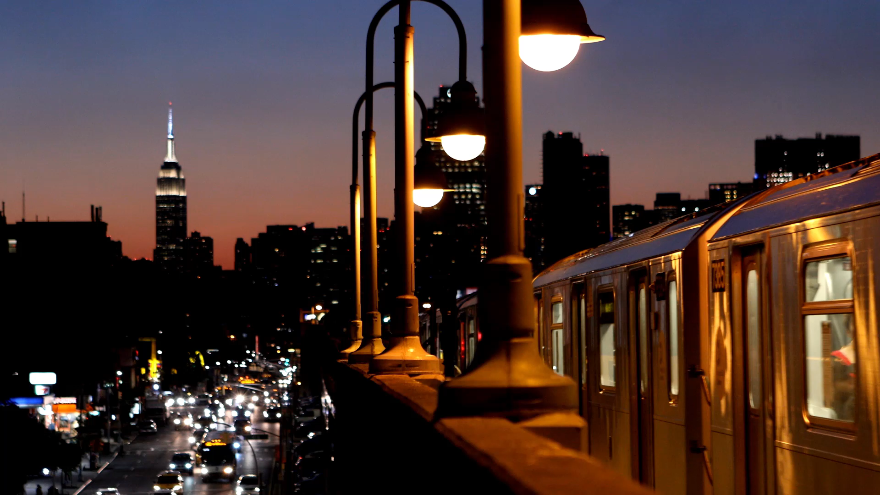
DAA SEMINAR BASED ON M – COLOURING
GROUP MEMBERS :
U19CS001 : PARVA SHAILESHKUMAR PATEL
U19CS025 : JINIL JIGARKUMAR THAKKAR
U19CS026 : SUMEET SANJAY KAMBLE
U19CS030 : YASH MAHESHBHAI PATEL

Slide 2
Approach 2 : Backtracking
Assumptions :
Here , only 3 colours since M = 3 .
White colour as colourless / un-coloured = 0
Red colour = 1
Blue colour = 2
Orange colour = 3
= temporary coloured (checking if colouring is possible or not)
A colour Array with nos. of elements = nos. of vertices = N (here = 10)
Say C[10] , and Initializing all elements with 0 ( i.e colourless )
C = { 0 , 0 , 0 , 0 , 0 , 0 , 0 , 0 , 0 , 0 };
Graph[n][n] is a binary matrix , in which if Graph[i][j] = 1 it denotes edge between
I and J and 0 means no edge .

Slide 3
Algorithm :
We will iterate (i) from vertex 1 to N ( i.e. 10)
And Colour Each vertex but before colouring We will check whether the vertex V will be
Coloured is safe or not .
( i.e if adjacent vertices doesn’t have
Same colour as vertex V. )
If it is different then we will
colour it and move onto next
vertex or else we will check again with different colour and repeat this process
until we get The desired result / graph.
Same Input taken as it was in Algo-1 (Naive)
1
= 1
= 2
= 3
2
4
5
3
6
7
8
9
10

Slide 4
Depth of recursion
C = { 0 , 0 , 0 , 0 , 0 , 0 , 0 , 0 , 0 , 0 }
1
= 1
i = 0
= 2
We will try to colour Vertex 1 with 1 (red) , and check whether it is possible .
= 3
2
4
5
3
6
7
8
9
10

Slide 5
Depth of recursion
C = { 1 , 0 , 0 , 0 , 0 , 0 , 0 , 0 , 0 , 0 }
1
= 1
i = 0
= 2
We will colour vertex 1 as red since Coloring is possible ,
Since all adjacent vertices are of different colour (here colourless)
= 3
2
4
5
3
6
7
8
9
10

Slide 6
Depth of recursion
C = { 1 , 0 , 0 , 0 , 0 , 0 , 0 , 0 , 0 , 0 }
1
= 1
i = 1
= 2
We will try to colour Vertex 2 with 1 (red) , and check whether it is possible .
i = 0
= 3
2
4
5
3
6
7
8
9
10

Slide 7
Depth of recursion
C = { 1 , 0 , 0 , 0 , 0 , 0 , 0 , 0 , 0 , 0 }
1
= 1
i = 1
= 2
Since Edge 1 - 2
Share same colour , therefore it is not valid , and hence we will try some other colour for vertex 2
i = 0
= 3
2
4
5
3
6
7
8
9
10

Slide 8
Depth of recursion
C = { 1 , 0 , 0 , 0 , 0 , 0 , 0 , 0 , 0 , 0 }
1
= 1
i = 1
= 2
Since Red was invalid now we will check with blue colour (next colour )
i = 0
= 3
2
4
5
3
6
7
8
9
10

Slide 9
Depth of recursion
C = { 1 , 2 , 0 , 0 , 0 , 0 , 0 , 0 , 0 , 0 }
1
= 1
i = 1
= 2
Since Blue is Valid We will colour Vertex 2 with Blue
i = 0
= 3
2
4
5
3
6
7
8
9
10

Slide 10
Depth of recursion
C = { 1 , 2 , 0 , 0 , 0 , 0 , 0 , 0 , 0 , 0 }
1
= 1
i = 2
= 2
Again , We will repeat same process for vertex 3.
We will try to colour it with red
i = 1
= 3
i = 0
2
4
5
3
6
7
8
9
10

Slide 11
Depth of recursion
C = { 1 , 2 , 0 , 0 , 0 , 0 , 0 , 0 , 0 , 0 }
1
= 1
i = 2
= 2
Since Edge 1 – 3 ,
We will try next colour blue
And check whether it is safe or not .
i = 1
= 3
i = 0
2
4
5
3
6
7
8
9
10

Slide 12
Depth of recursion
C = { 1 , 2 , 2 , 0 , 0 , 0 , 0 , 0 , 0 , 0 }
1
= 1
i = 2
= 2
Blue colour for vertex 3 is safe so we will colour it .
And move onto next vertex .
i = 1
= 3
i = 0
2
4
5
3
6
7
8
9
10

Slide 13
Depth of recursion
C = { 1 , 2 , 2 , 0 , 0 , 0 , 0 , 0 , 0 , 0 }
1
= 1
i = 3
= 2
Again same process for vertex 4 ,
Checking it with red colour .
i = 2
= 3
i = 1
2
i = 0
4
5
3
6
7
8
9
10

Slide 14
Depth of recursion
C = { 1 , 2 , 2 , 1 , 0 , 0 , 0 , 0 , 0 , 0 }
1
= 1
i = 3
= 2
Since Vertex 4 with red is safe we will colour it with red
i = 2
= 3
i = 1
2
i = 0
4
5
3
6
7
8
9
10

Slide 15
Depth of recursion
C = { 1 , 2 , 2 , 1 , 0 , 0 , 0 , 0 , 0 , 0 }
1
= 1
i = 4
= 2
Again same process
with Vertex 5 :
Here it is not safe since
4-5 edge share same colour
i = 3
= 3
i = 2
2
i = 1
i = 0
4
5
3
6
7
8
9
10

Slide 16
Depth of recursion
C = { 1 , 2 , 2 , 1 , 0 , 0 , 0 , 0 , 0 , 0 }
1
= 1
i = 4
= 2
Hence we will try next colour
i.e blue (2)
i = 3
= 3
i = 2
2
i = 1
i = 0
4
5
3
6
7
8
9
10

Slide 17
Depth of recursion
C = { 1 , 2 , 2 , 1 , 2 , 0 , 0 , 0 , 0 , 0 }
1
= 1
i = 4
= 2
Since , Vertex 5 with blue
Colour is safe , we will colour it .
And move onto next vertex .
i = 3
= 3
i = 2
2
i = 1
i = 0
4
5
3
6
7
8
9
10

Slide 18
Depth of recursion
C = { 1 , 2 , 2 , 1 , 2 , 0 , 0 , 0 , 0 , 0 }
1
= 1
i = 5
= 2
Again same with vertex 6
Checking with red colour
Here it is unsafe since 1 – 6 edge
Vertices share same colour .
i = 4
= 3
i = 3
2
i = 2
i = 1
4
5
i = 0
6
3
7
8
9
10

Slide 19
Depth of recursion
C = { 1 , 2 , 2 , 1 , 2 , 0 , 0 , 0 , 0 , 0 }
1
= 1
i = 5
= 2
Trying next colour i.e blue
Again it is NOT SAFE since
5 – 6 edge vertices share same colour .
i = 4
= 3
i = 3
2
i = 2
i = 1
4
5
i = 0
6
3
7
8
9
10

Slide 20
Depth of recursion
C = { 1 , 2 , 2 , 1 , 2 , 0 , 0 , 0 , 0 , 0 }
1
= 1
i = 5
= 2
Trying Next Colour i.e Orange .
i = 4
= 3
i = 3
2
i = 2
i = 1
4
5
i = 0
6
3
7
8
9
10

Slide 21
Depth of recursion
C = { 1 , 2 , 2 , 1 , 2 , 3 , 0 , 0 , 0 , 0 }
1
= 1
i = 5
= 2
Since vertex 6 is safe with orange , we will colour it .
And move onto next vertex .
i = 4
= 3
i = 3
2
i = 2
i = 1
4
5
i = 0
6
3
7
8
9
10

Slide 22
Depth of recursion
C = { 1 , 2 , 2 , 1 , 2 , 3 , 0 , 0 , 0 , 0 }
1
= 1
i = 6
= 2
Again same with Vertex 7 ,
Checking with red colour ,
Here it is SAFE .
i = 5
= 3
i = 4
2
i = 3
i = 2
4
5
i = 1
3
6
i = 0
7
8
9
10

Slide 23
Depth of recursion
C = { 1 , 2 , 2 , 1 , 2 , 3 , 1 , 0 , 0 , 0 }
1
= 1
i = 6
= 2
Since it is SAFE , we will colour
Vertex 7 with red . And move onto next vertex .
i = 5
= 3
i = 4
2
i = 3
i = 2
4
5
i = 1
3
6
i = 0
7
8
9
10

Slide 24
Depth of recursion
C = { 1 , 2 , 2 , 1 , 2 , 3 , 1 , 0 , 0 , 0 }
1
= 1
i = 7
= 2
Again same with Vertex 8 ,
Checking with red colour ,
Here it is NOT SAFE
Since Edge 4 – 8 share same colour .
i = 6
= 3
i = 5
2
i = 4
i = 3
4
5
i = 2
6
3
i = 1
i = 0
7
8
9
10

Slide 25
Depth of recursion
C = { 1 , 2 , 2 , 1 , 2 , 3 , 1 , 0 , 0 , 0 }
1
= 1
i = 7
= 2
Checking with next colour i.e blue colour ,
Here , it is NOT SAFE
Since , edge 8 – 2 share same colour .
i = 6
= 3
i = 5
2
i = 4
i = 3
4
5
i = 2
6
3
i = 1
i = 0
7
8
9
10

Slide 26
Depth of recursion
C = { 1 , 2 , 2 , 1 , 2 , 3 , 1 , 0 , 0 , 0 }
1
= 1
i = 7
= 2
Checking with next colour i.e orange colour ,
Here , it is SAFE
i = 6
= 3
i = 5
2
i = 4
i = 3
4
5
i = 2
6
3
i = 1
i = 0
7
8
9
10

Slide 27
Depth of recursion
C = { 1 , 2 , 2 , 1 , 2 , 3 , 1 , 3 , 0 , 0 }
1
= 1
i = 7
= 2
Since it is SAFE we will colour vertex 8 with orange and move onto next vertex .
i = 6
= 3
i = 5
2
i = 4
i = 3
4
5
i = 2
6
3
i = 1
i = 0
7
8
9
10

Slide 28
Depth of recursion
C = { 1 , 2 , 2 , 1 , 2 , 3 , 1 , 3 , 0 , 0 }
1
= 1
i = 8
= 2
Similarly on Vertex 9 ,
Red / blue colour doesnot work
Since edge 9 – 7 and 9 – 3 resp.
i = 7
= 3
i = 6
2
i = 5
i = 4
4
5
i = 3
3
6
i = 2
i = 1
7
8
i = 0
9
10

Slide 29
Depth of recursion
C = { 1 , 2 , 2 , 1 , 2 , 3 , 1 , 3 , 0 , 0 }
1
= 1
i = 8
= 2
Similarly on Vertex 9 ,
Red / blue colour doesnot work
Since edge 9 – 7 and 9 – 3 resp.
i = 7
= 3
i = 6
2
i = 5
i = 4
4
5
i = 3
3
6
i = 2
i = 1
7
8
i = 0
9
10

Slide 30
Depth of recursion
C = { 1 , 2 , 2 , 1 , 2 , 3 , 1 , 3 , 0 , 0 }
1
= 1
i = 8
= 2
Therefore with orange colour it is SAFE
i = 7
= 3
i = 6
2
i = 5
i = 4
4
5
i = 3
3
6
i = 2
i = 1
7
8
i = 0
9
10

Slide 31
Depth of recursion
C = { 1 , 2 , 2 , 1 , 2 , 3 , 1 , 3 , 3 , 0 }
1
= 1
i = 8
= 2
Colouring vertex 9 with Orange i.e 3
i = 7
= 3
i = 6
2
i = 5
i = 4
4
5
i = 3
3
6
i = 2
i = 1
7
8
i = 0
9
10

Slide 32
Depth of recursion
C = { 1 , 2 , 2 , 1 , 2 , 3 , 1 , 3 , 3 , 0 }
1
= 1
i = 9
= 2
Again same with Vertex 10
Checking with red colour ,
Here it is SAFE .
i = 8
= 3
i = 7
2
i = 6
i = 5
4
5
i = 4
3
6
i = 3
i = 2
7
8
i = 1
i = 0
9
10

Slide 33
Depth of recursion
C = { 1 , 2 , 2 , 1 , 2 , 3 , 1 , 3 , 3 , 1 }
1
= 1
i = 9
= 2
Since SAFE , we will colour vertex 10 with red ,
And move forward in recursion
i = 8
= 3
i = 7
2
i = 6
i = 5
4
5
i = 4
3
6
i = 3
i = 2
7
8
i = 1
i = 0
9
10

Slide 34
Depth of recursion
C = { 1 , 2 , 2 , 1 , 2 , 3 , 1 , 3 , 3 , 1 }
1
= 1
i = 10
= 2
SINCE I = V
We will exit all recurions since the graph we obtained is correct /
One of the possible colouring pattern .
i = 9
= 3
i = 8
2
i = 7
i = 6
4
5
i = 5
3
6
i = 4
i = 3
7
8
i = 2
i = 1
i = 0
9
10

Slide 35
Depth of recursion
C = { 1 , 2 , 2 , 1 , 2 , 3 , 1 , 3 , 3 , 1 }
1
= 1
Return true;
Return true;
Return true;
Return true;
Return true;
Return true;
Return true;
Return true;
Return true;
Return true;
Return true;
i = 10
How the algorithm exit all recurisons
(all will return true and print final answer)
= 2
i = 9
= 3
i = 8
2
i = 7
i = 6
4
5
i = 5
3
6
i = 4
i = 3
7
8
i = 2
i = 1
i = 0
And then it will
print final Colour Array
9
10

Slide 36
Here , since the initial pattern worked .
We didn’t had to go back in recursion to re-colour previous vertex in order to try some new colour combination .
Otherwise We backtrack the colour combinations and try efficiently new colour .
Only difference of Algo – 2 (Backtracking) and Algo -1 (Naive) is that we check whether each vertex is safe or not , which helps to improve time complexity for average cases ,
But it’s worst case still remains same as this is still an brute force algorithm optimization .

Slide 37
Finally :
Depth of recursion = 0
1
= 1
= 2
= 3
Final Colour Order of Vertices :
C = { 1 , 2 , 2 , 1 , 2 , 3 , 1 , 3 , 3 , 1 }
In Simpler Terms , This Algorithm is Bactracking Approach which efficiently tries all possible combination which will give better results in average cases but worst time will still remains same i.e 3¹⁰
(in this case) As seen in previous slide .
And print the right / safely m – coloured graph or returns Not Possible if it isn’t
Possible
2
4
5
3
6
7
8
9
10

